Slide 1
Customer Retention Project
Submitted by
Akash

Slide 2
Table of Content
Introduction of project
Data cleaning
Data visualization
Data scaling
Data preprocessing

Slide 3
Introduction
E-commerce is a crucial part of our lives in this age. The boundaries of online retail are expanding and providing us with complete flexibility while shopping.
The idea that originated out of convenience has now become a symbol of flagship and authentic products. The number of online retail businesses are increasing due to the internet era and huge popularity, this brings in a whole field of competition between these corporations. Data analysis is the key for keeping the top spot.
Companies must be prepared to face the problem of customer retention. While attracting customers is made easy by marketing the monetary benefits, keeping the consumers loyal is one hard task. Retention directly translates to satisfaction in our case. Higher the number of satisfied consumers, more will be the number of retentions. We now need to understand the factors affecting the happiness of the consumers.
This is where data analysis comes in. The data collected by surveys and other methods are analysed methodically keeping in mind the target is to achieve user recommendation. More recommendations give the general attitude of the users which can be used to understand user contentment.

Slide 4
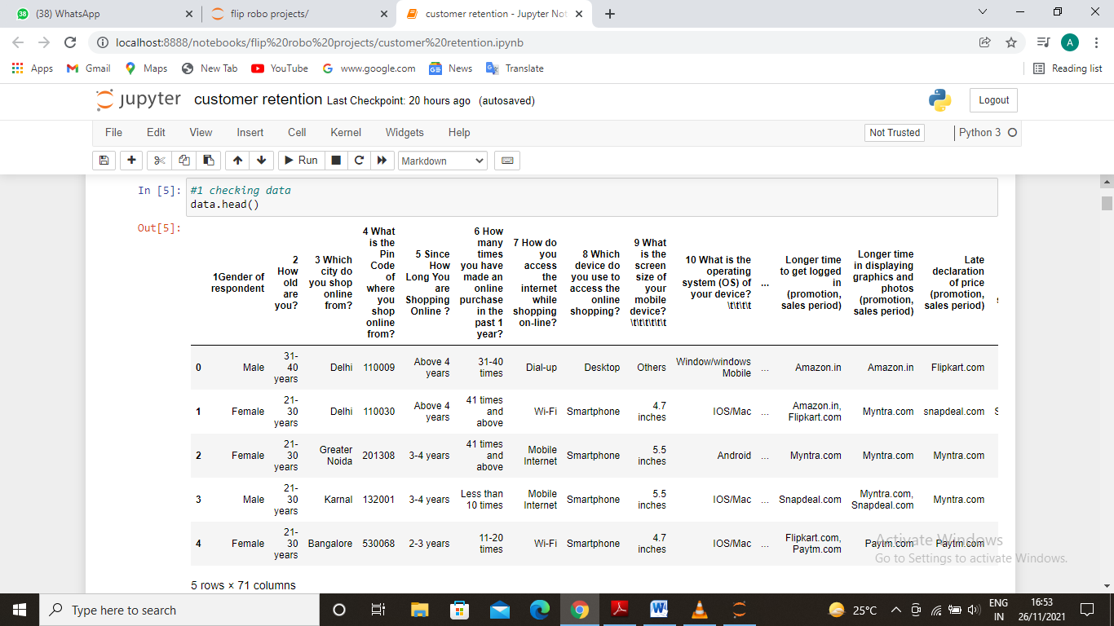
Understanding the model
The data used for analysis purpose the chances of growing the e-commerce in india and predict is it safe or not. The data contains 269 rows and 71 columns. The data includes both in integer and string forms.

Slide 5
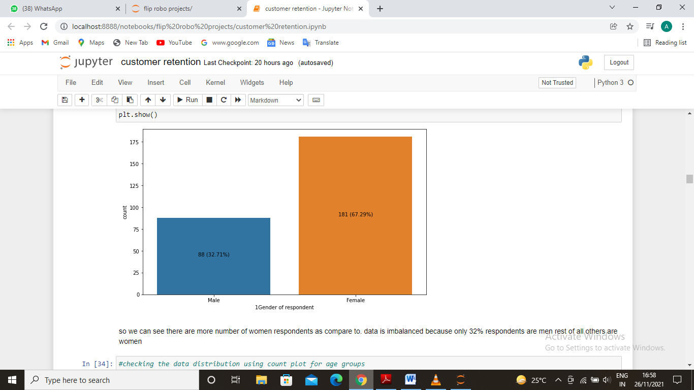
Data Cleaning and Understanding
First of all we got data the data is in excel file so we import this into our model. we need to cleaning up the data although it is a very messed data because we need to doing the proper cleaning so we just added only those columns which we need the most so first we need to clean the data in the data there are 269 rows and 71 columns. Than we correlate the targeted variable with some important independent variables. we have dropped some of unnecessary columns which will not help us to making the model. The data is very inbalanced because there are 67.27% female respondents and 32.63% male respondents. So we need to take steps accordingly.

Slide 6
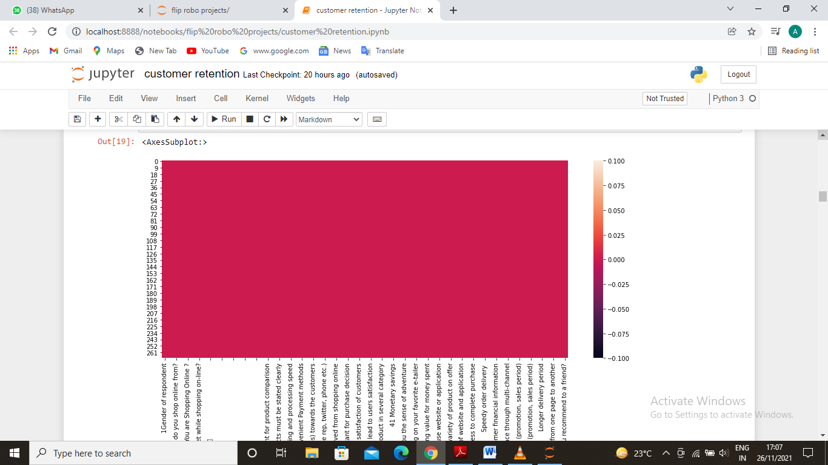
Heat map for null values before and after data cleaning

Slide 7
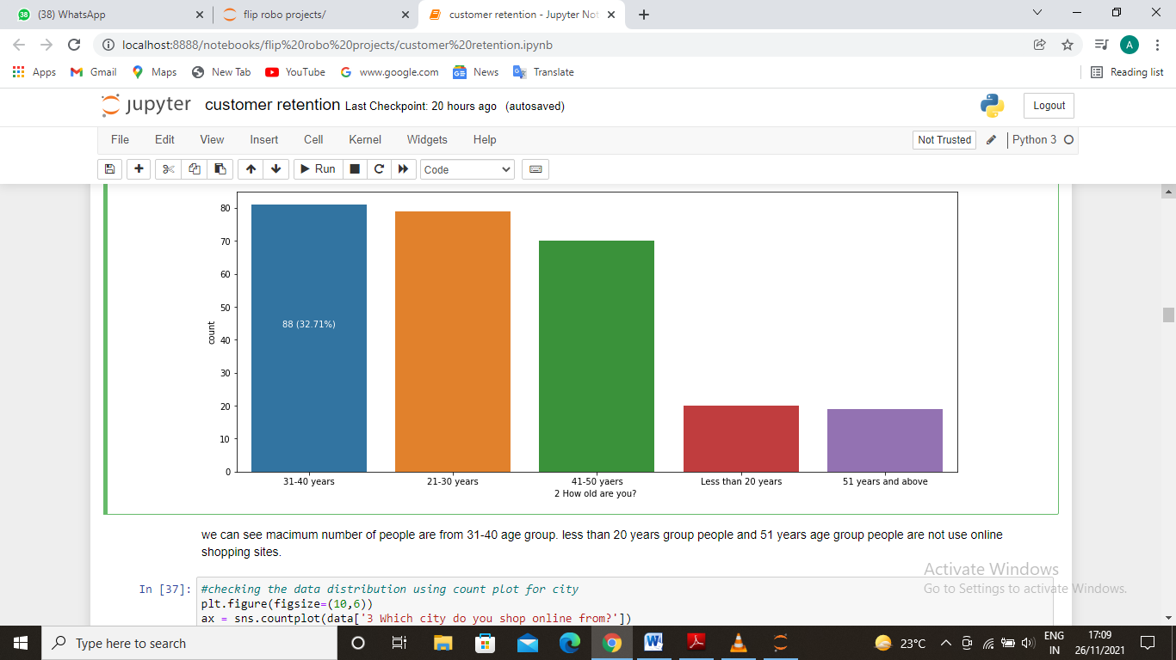
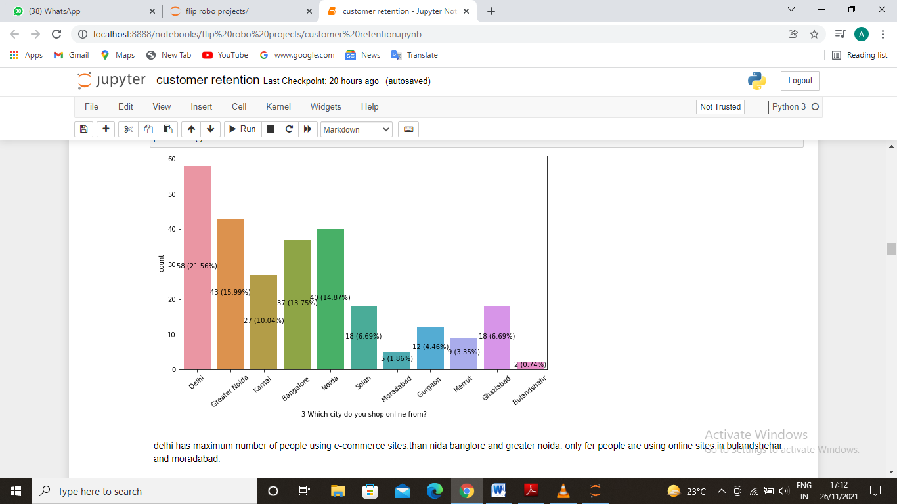
Data visualization
Visualization includes the relationships or independent variables with the targeted variable.
First diagram is the checking the data distribution using count plot for age groups.
Second diagram checking the data distribution using count plot for city.
Observation of first - we can see macimum number of people are from 31-40 age group. less than 20 years group people and 51 years age group people are not use online shopping sites.
Observation of second - delhi has maximum number of people using e-commerce sites.than nida banglore and greater noida. only fer people are using online sites in bulandshehar and moradabad.

Slide 8
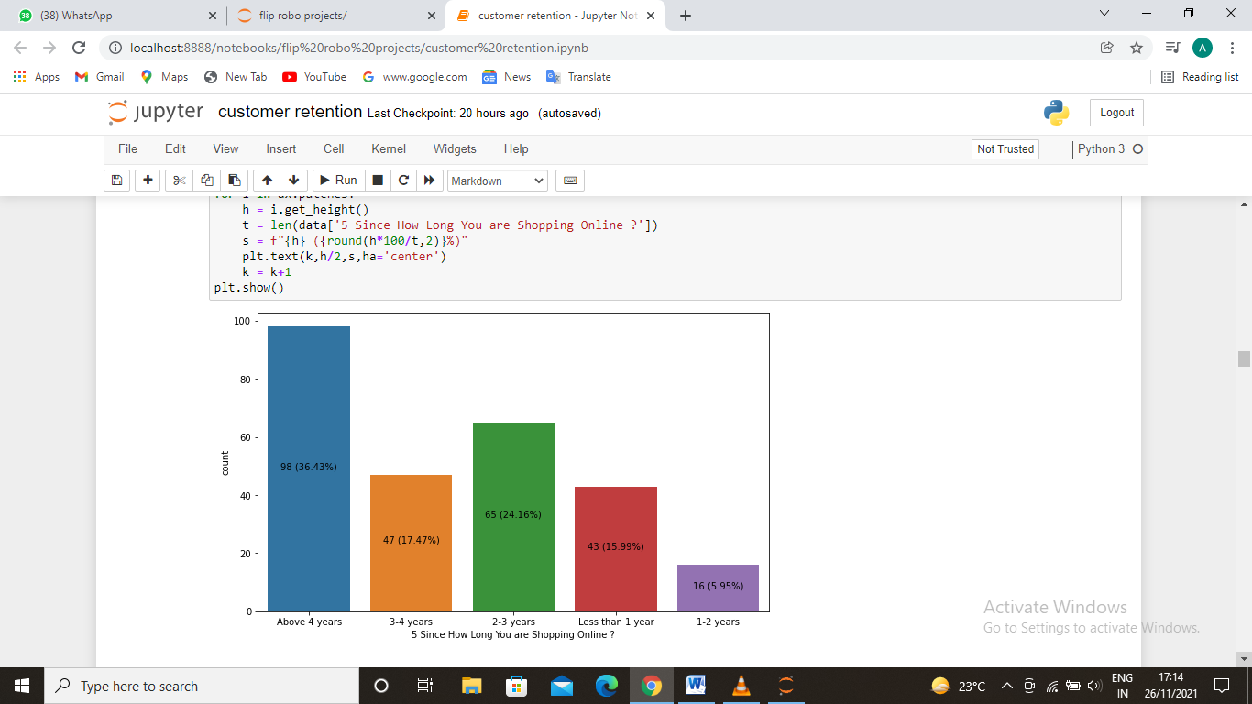
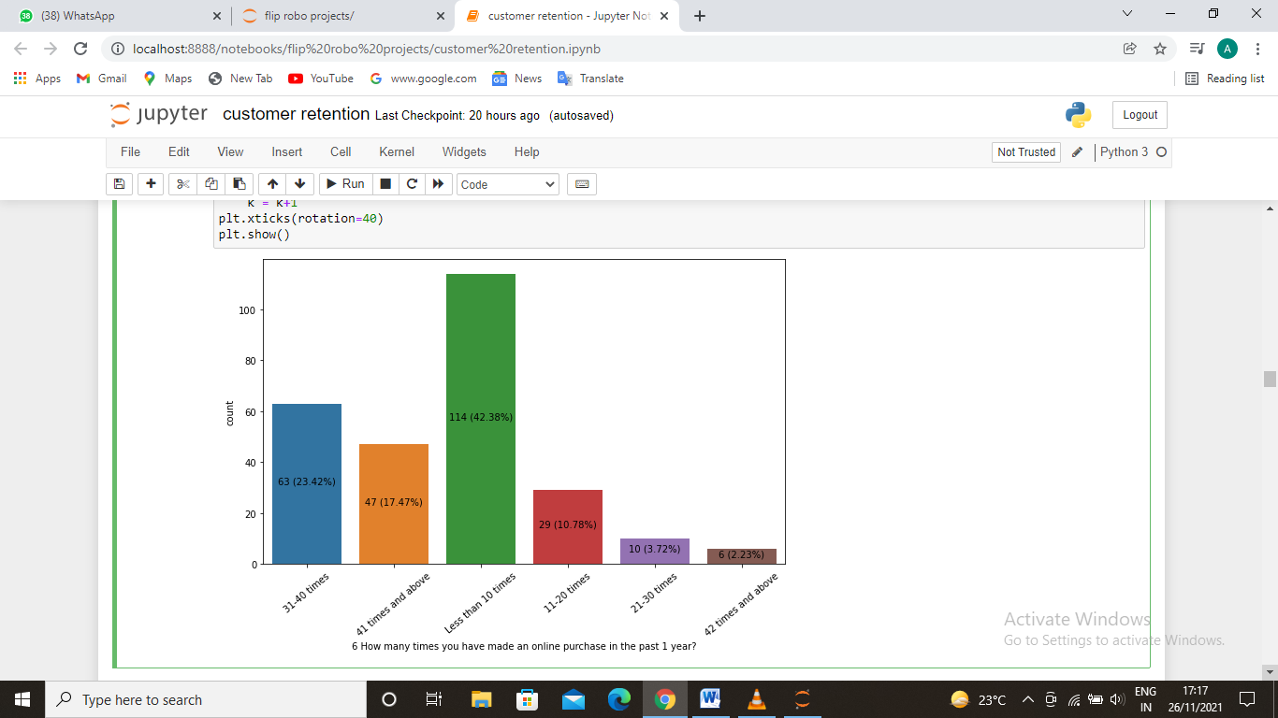
Third diagram is checking the data distribution using count plot for time to use ecommerce.
Fourth diagram is checking the data distribution using count plot for last time orderd.
Observation of first - maximum people are using the ecommerce sites more than 4 years and numbers are increasing for the people using shopping sites.
Observation of second- most of the people are place order less than 10 times and very fer people order more than 42 times in a year.

Slide 9
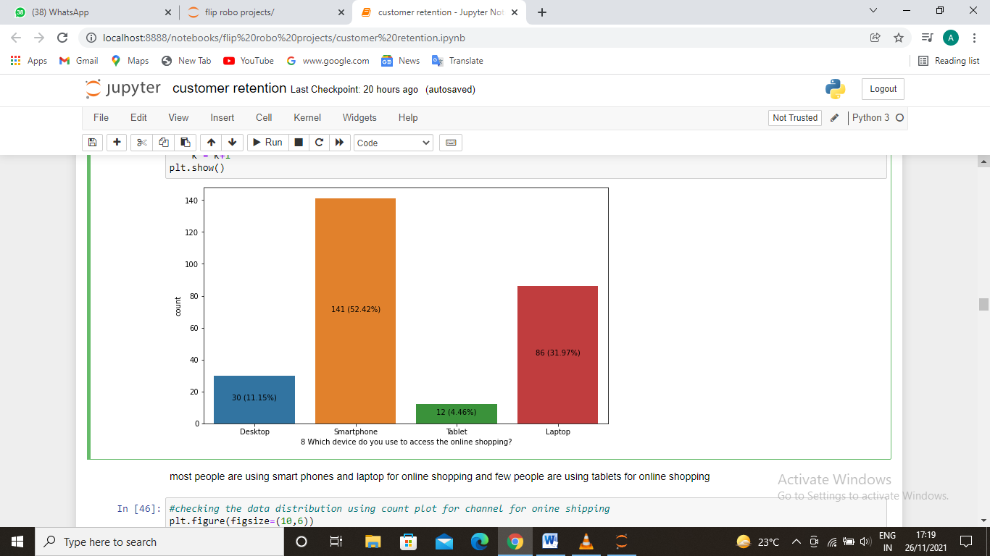
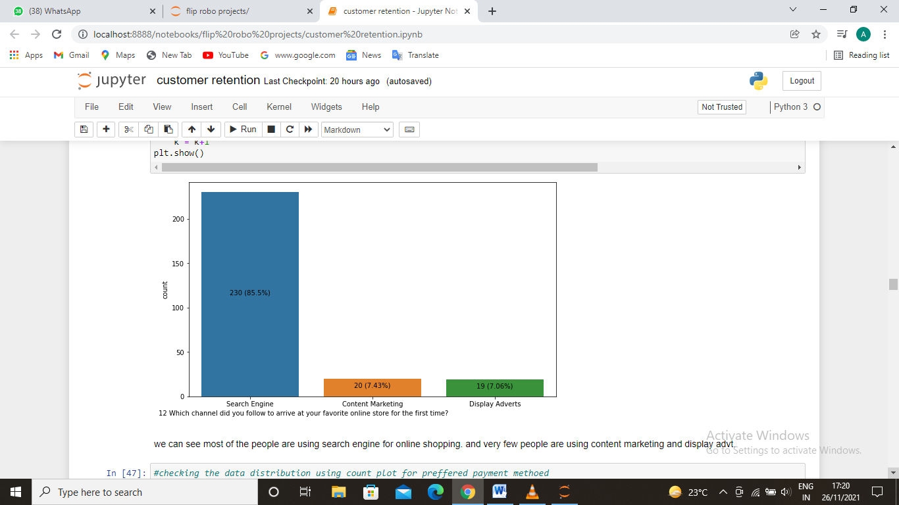
Fifth diagram is checking the data distribution using count plot for mode of shopping.
Sixth diagram is checking the data distribution using count plot for channel for onine shipping.
Observation of first - most people are using smart phones and laptop for online shopping and few people are using tablets for online shopping.
Observation of second- we can see most of the people are using search engine for online shopping. and very few people are using content marketing and display advt.

Slide 10
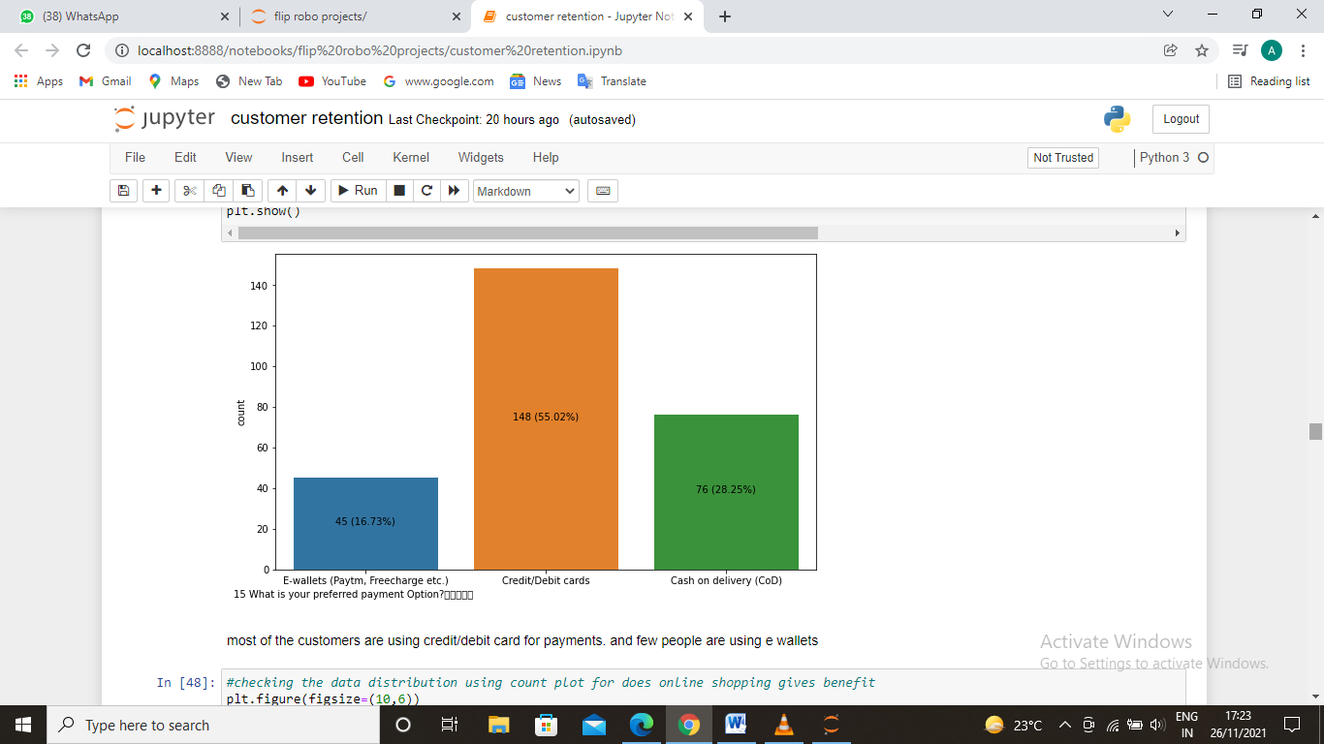
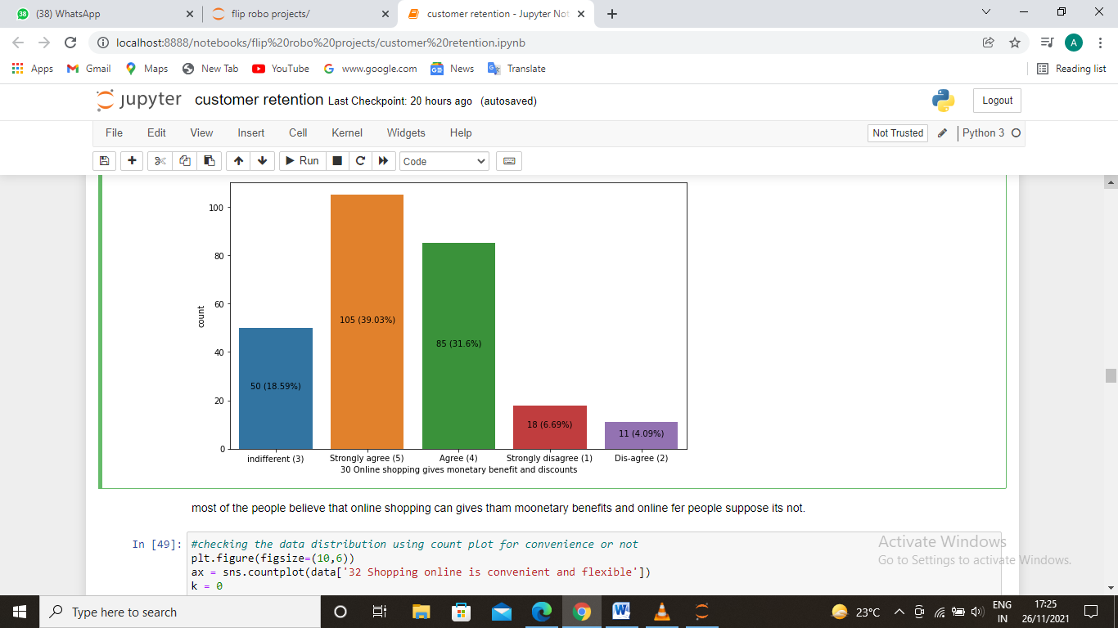
seventh diagram is checking the data distribution using count plot for preffered payment method.
Eighth diagram is checking the data distribution using count plot for does online shopping gives benefit.
Observation of first - most of the customers are using credit/debit card for payments. and few people are using e wallets.
Observation of second-most of the people believe that online shopping can gives tham moonetary benefits and online fer people suppose its not

Slide 11
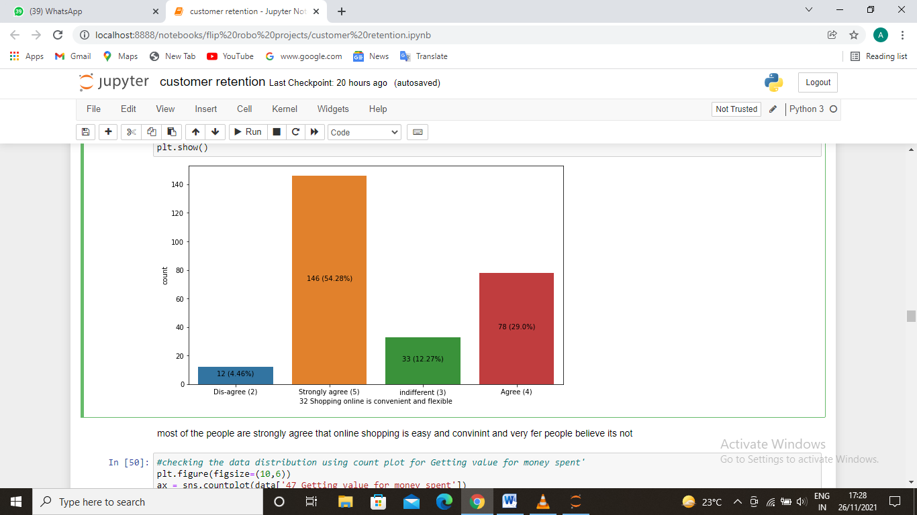
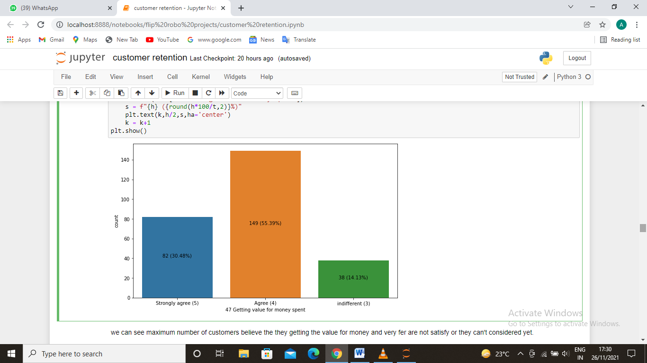
ninth diagram is checking the data distribution using count plot for convenience or not..
tenth diagram is checking the data distribution using count plot for Getting value for money spent.
Observation of first - most of the people are strongly agree that online shopping is easy and convinint and very fer people believe its not.
Observation of second-we can see maximum number of customers believe the they getting the value for money and very fer are not satisfy or they can't considered yet.

Slide 12
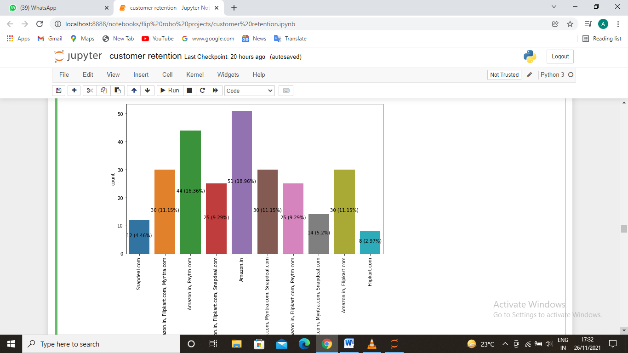
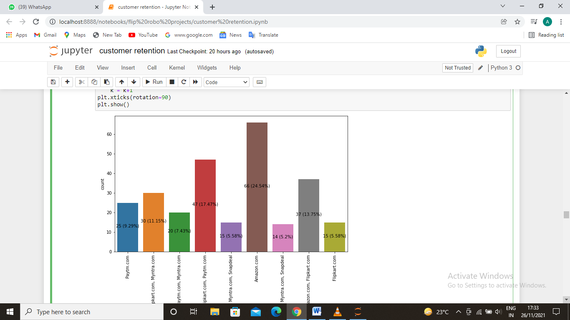
eleventh diagram is checking the data distribution using count plot for Fast loading website speed of website and application.
Twelfth diagram is checking the data distribution using count plot for Quickness to complete purchase.
Observation of first - amazon is the leading website for e-commerce and its used by most of the customers and flipkart is back in the list.
Observation of second-amazon is the quickest site to complete the purchase in other words customers can complete the purchase fastest as compared to other websites and flipkart is slower in the list.

Slide 13
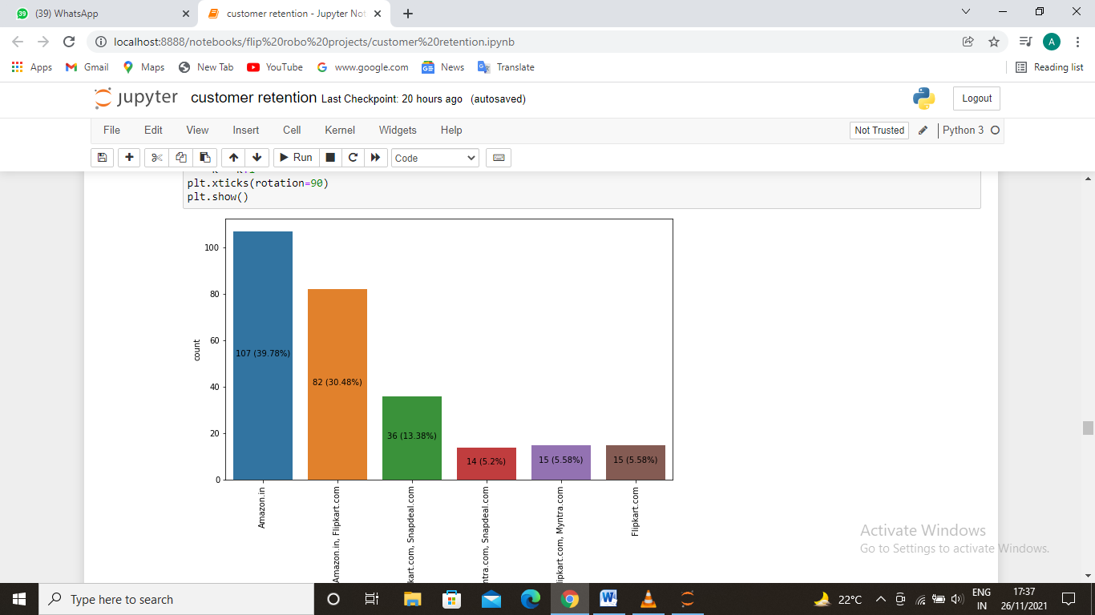
thirteenth diagram is checking the data distribution using count plot for Speedy order delivery.
Fourteenth diagram is checking the data distribution using count plot for Perceived Trustworthiness..
Observation of first - amazon is the fastest site to deliver the products to the customers and flipkart is slowest.
Observation of second-amazon is the fastest site to deliver the products to the customers and flipkart is slowest.

Slide 14
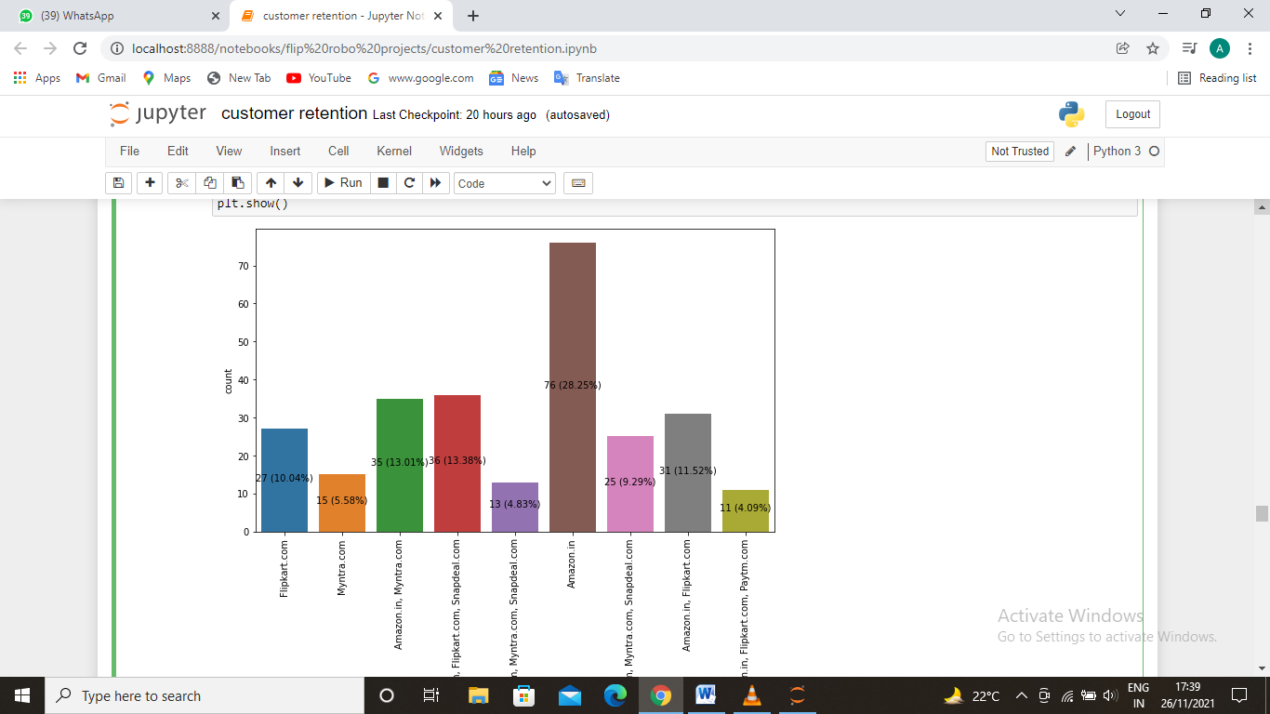
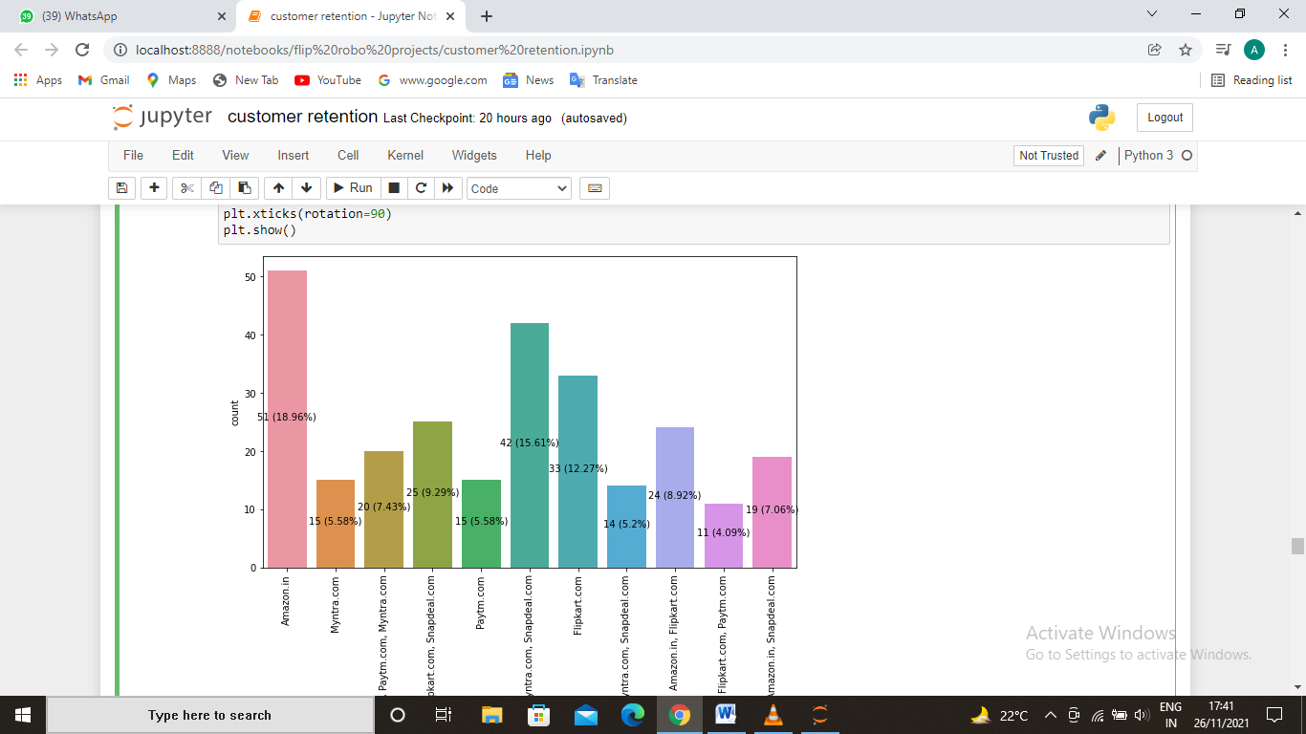
Fifteenth diagram is checking the data distribution using count plot for Perceived Trustworthiness.
Sixteenth diagram is checking the data distribution using count plot for Security of customer financial information.
Observation of first - amazon is top in trustworthiness for customers and myntra is not upto trustworthiness.
Observation of second-amazon is the best website for security of customer financial information and myntra does not suggested by costomers.

Slide 15
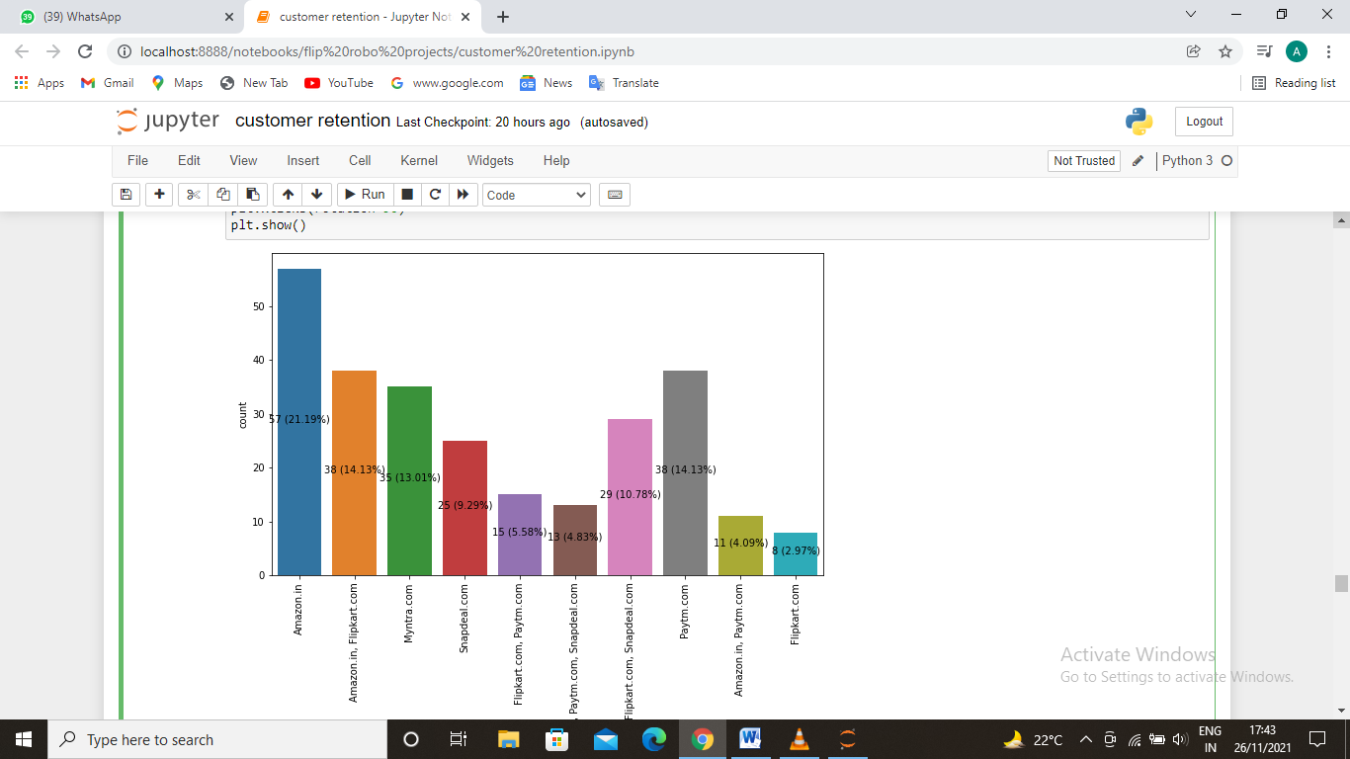
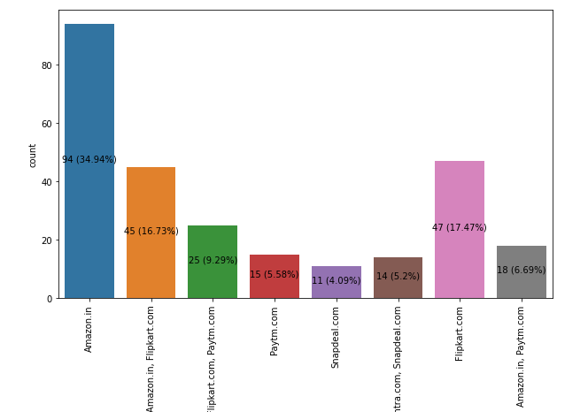
Seventeenth diagram is checking the data distribution using count plot for Longer time to get logged in (promotion, sales period.
Eighteenth diagram is checking the data distribution using count plot for Website is as efficient as before.
Observation of first - amazon have all the goood things but amazon tooks to long to get logged in for users. and flipkart is quickest site for logging in.
Observation of second-according to our data amazon.in is as effecient as it before but snapdeal, paytm and flipkart are changing.
.

Slide 16
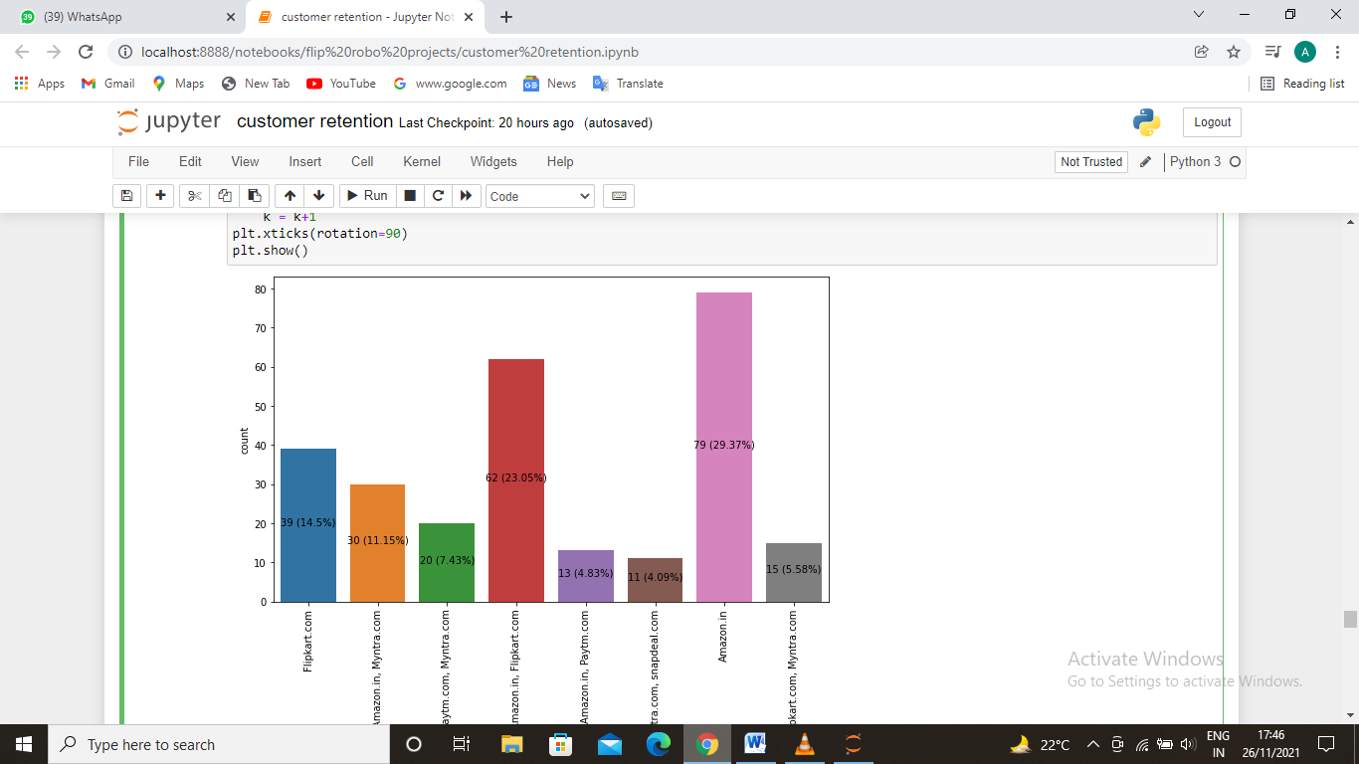
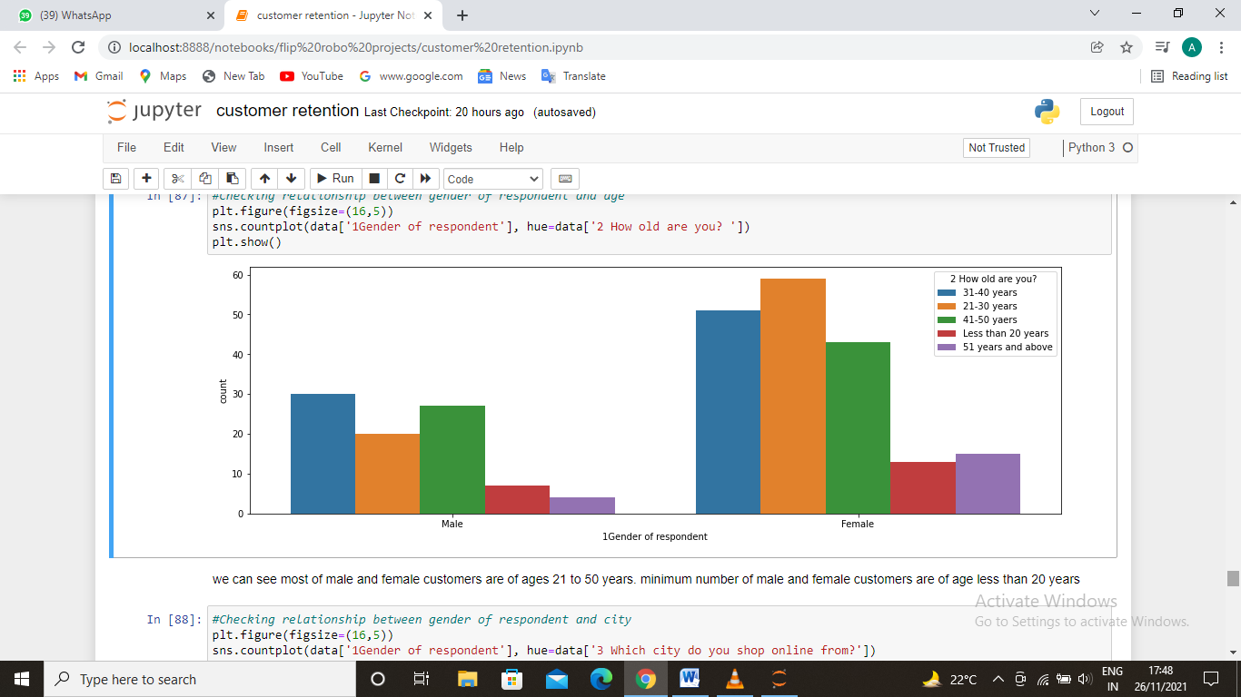
Nineteenth diagram is checking the data distribution using count plot for Which of the Indian online retailer would you recommend to a friend?
Twentieth diagram is Checking relationship between gender of respondent and age.
Observation of first - most of the people are recommending amazon.in to their family and friends while very few people are recommeding paytm to their family and friends.
Observation of second-we can see most of male and female customers are of ages 21 to 50 years. minimum number of male and female customers are of age less than 20 years.
.

Slide 17
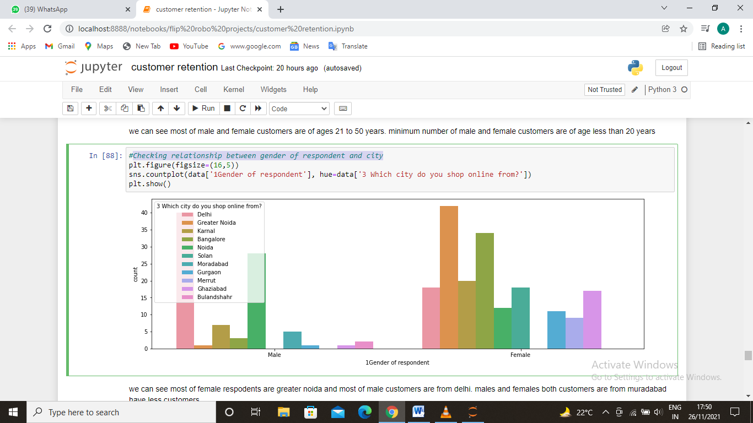
diagram is showing the relationship between gender of respondent and city.
Observation - we can see most of female respodents are greater noida and most of male customers are from delhi. males and females both customers are from muradabad have less customers

Slide 18
Conclusion
We can see in the above analysis the e-commerce is booming sector. and the number of users are increasing day by day as most of the customer find it enjoyable, value for money, they believe its realiable and there are some trustworthy sites like amazon which provide the secuity to the user and financial protection also. some sites are delaying the orders but they changing with the time so people are using the ecommerce site for shopping as using it is fun. so we can conclude that the e-commerce sites will boom in the future as number of customers increasing and its convinient. and amazon is leading the e-commerce market with the maximum number of buyers and maxium number of varieties of product on their site.

